Slide 1

Department of Computer Science and Engineering
(Cyber Security)
CS23533– Foundations of Artificial Intelligence
2026-2027
Intelligent University Timetable Generator
Dr. S. Bhuvana
Assistant Professor[SG]
Ponsurabhi.V 241901077
Swarnamala.V 241901116

Slide 2
Problem Statement and Motivation
Problem Statement
University timetable generation involves assigning subjects, faculty members, classrooms, laboratories, and periods without conflicts.
Manual scheduling is time-consuming and prone to errors.
Faculty unavailability can disrupt an existing timetable and require several changes.
Conventional timetable generation may require regenerating the entire timetable even when only a few classes are affected.

Slide 3
Problem Statement and Motivation
Motivation
Automate timetable generation using classical Artificial Intelligence techniques.
Reduce faculty, classroom, and section conflicts.
Adapt to faculty leave while preserving unaffected timetable assignments.
Improve scheduling efficiency, consistency, and maintainability.
Problem Addressed
How can a university timetable be generated automatically and adapted to changes using CSP while minimizing unnecessary changes to the existing schedule?

Slide 4
Objectives
Primary Objectives
Develop an automated university timetable generator using Constraint Satisfaction Problems.
Model class sessions, time slots, faculty, sections, rooms, and laboratories as CSP variables and constraints.
Implement Backtracking Search to find valid timetable assignments.
Apply Minimum Remaining Values (MRV), Least Constraining Value (LCV), and Forward Checking to improve search efficiency.
Develop an adaptive rescheduling mechanism for faculty leave.
Preserve unaffected timetable assignments whenever possible.

Slide 5
Objectives
Expected Outcomes
Conflict-free timetable generation.
Automatic identification of affected classes.
Reduced unnecessary timetable modifications.
Role-based access for administrators, faculty, and students.
Evaluation using execution time, search nodes, backtracks, constraint checks, and timetable stability.
Current Status
Core timetable generation, role-based interfaces, and the adaptive rescheduling demonstration have been implemented.

Slide 6
Abstract
Intelligent Adaptive University Timetable Generator Using Constraint Satisfaction Problem (CSP)
University timetable scheduling is a complex task involving the allocation of subjects, faculty members, classrooms, laboratories, and time slots while satisfying multiple constraints. Manual scheduling is time-consuming and may lead to conflicts and difficulties when changes occur. This project proposes an Intelligent Adaptive University Timetable Generator using Constraint Satisfaction Problems (CSP).

Slide 7
Abstract
The system models class sessions as variables, valid day–period–room combinations as domains, and scheduling requirements as constraints. Backtracking Search, Minimum Remaining Values (MRV), Least Constraining Value (LCV), and Forward Checking are used to support timetable generation.
The system also incorporates an adaptive rescheduling mechanism to handle faculty leave. It identifies affected classes, checks for suitable substitutes, and attempts to reschedule affected assignments while preserving unaffected classes.

Slide 8
Abstract
The application is developed using Python, Flask, and SQLite, with separate interfaces for administrators, faculty, and students. The system aims to reduce scheduling conflicts, minimize unnecessary timetable modifications, and improve scheduling efficiency.
Keywords: Artificial Intelligence, Constraint Satisfaction Problem, Backtracking Search, University Timetabling, Adaptive Rescheduling.

Slide 9
Literature Survey
S. No. | Author(s) & Year | Paper Title | Methodology / Algorithm | Limitations
1 | Lixi Zhang and Sim Kim Lau, 2005 | Constructing University Timetable Using Constraint Satisfaction Programming Approach | University Timetable Using Constraint Satisfaction Programming Approach | Provides a CSP-based scheduling foundation; adaptive rescheduling with minimal timetable changes is the focus of our extension.
2 | Burke et al., 2004 | The State of the Art of University Timetabling | Survey of university timetabling approaches and optimization techniques | timetabling approaches and optimization techniques
3 | Dechter, 2003 | Constraint Processing | CSP representation, constraint propagation, and search techniques | Provides general CSP methods; their application to our specific university scheduling and adaptive rescheduling requirements must be implemented and evaluated.

Slide 10
Literature Survey
S. No. | Author(s) & Year | Paper Title | Methodology / Algorithm | Limitations
4 | Russell and Norvig, 2021 | Artificial Intelligence: A Modern Approach | CSP, Backtracking Search, MRV, LCV, and constraint propagation | Provides the theoretical foundation for the implemented classical AI algorithms.
5 | Schaerf, 1999 | A Survey of Automated Timetabling | Review of automated timetabling methods and scheduling approaches | Establishes the challenges and constraints involved in automated timetable generation

Slide 11
RESEARCH GAP / EXISTING SYSTEM
1. Existing Systems
Manual timetable preparation requires significant administrative effort.
Conventional automated systems use scheduling algorithms to allocate classes to available time slots.
CSP provides a systematic approach to representing scheduling variables, domains, and constraints.
Faculty availability and classroom capacity influence timetable feasibility.
2. Limitations
Manual scheduling is susceptible to conflicts and human error.
Changes in faculty availability may require multiple timetable modifications.
Regenerating an entire timetable can unnecessarily affect previously valid assignments.
Maintaining timetable stability while satisfying new constraints remains an important scheduling challenge.

Slide 12
RESEARCH GAP / EXISTING SYSTEM
3. Research Gap
There is an opportunity to develop a timetable system that combines CSP-based scheduling with selective rescheduling of affected classes, reducing unnecessary changes to the existing timetable.
4. Proposed Solution
Formulate timetable generation as a CSP.
Apply Backtracking Search and search heuristics.
Identify assignments affected by faculty leave.
Check for a qualified substitute before rescheduling.
Use CSP to find a valid alternative for affected classes.
Preserve unaffected assignments whenever possible.

Slide 13
Proposed System
Proposed System Overview
The proposed system automatically generates university timetables using classical Artificial Intelligence techniques and adapts schedules when faculty availability changes.
Major Components
1. User Management
Administrator, faculty, and student interfaces.
Role-specific access to timetable functions.
2. Timetable Management
Manages departments, sections, subjects, faculty, rooms, and constraints.

Slide 14
Proposed System
Collects scheduling information required for timetable generation.
3. CSP-Based Timetable Generator
Represents class sessions as variables.
Defines valid day–period–room combinations as domains.
Enforces faculty, section, room, and laboratory constraints.
Uses Backtracking Search, MRV, LCV, and Forward Checking.
4. Adaptive Rescheduling
Processes faculty leave requests.
Identifies affected assignments.

Slide 15
Proposed System
Checks for suitable substitute faculty.
Reschedules affected classes when necessary.
5. Database and Output
Uses SQLite to store timetable-related information.
Displays department-wise, section-wise, and faculty-wise timetables.
Displays updated assignments after rescheduling

Slide 16
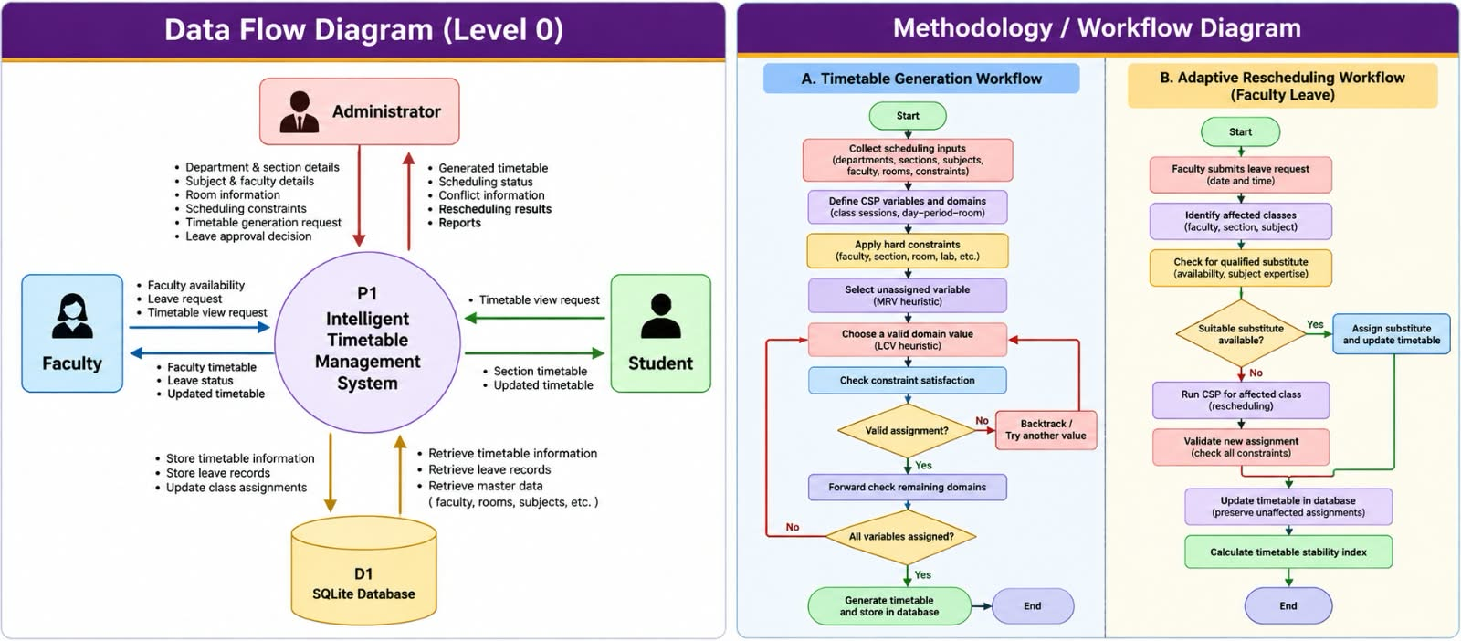
DFD Diagram

Slide 17
Methodology / Workflow Diagram

Slide 18
Tools and Technologies
Category | Technology | Purpose
Programming Language | Python | CSP implementation and backend logic
Web Framework | Flask | Web application and routing
Frontend | HTML, CSS, JavaScript | User interface and timetable display
Database | SQLite | Persistent storage of timetable data
AI Technique | CSP | Formal scheduling model
Search Algorithm | Backtracking Search | Assignment exploration
Heuristics | MRV and LCV | Variable and value ordering
Constraint Propagation | Forward Checking | Detect domain failures early
Development Environment | Visual Studio Code | Coding and debugging
Version Control | Git | Source-code management, if used

Slide 19
List of Modules
S. No. | Module | Function | Status
1 | University Data Management | Maintains university data, including departments, subjects, faculty, classrooms, and laboratories. | Completed
2 | CSP Formulation | Defines timetable variables, domains, and scheduling constraints. | Completed
3 | Constraint Validation | Checks faculty availability, room and section conflicts, laboratory requirements, and workload limits. | Completed
4 | Optimized Search | Applies Backtracking, MRV, LCV, and Forward Checking to generate feasible timetables. | Completed
5 | Adaptive Timetable Rescheduling | Handles faculty absences through substitution or rescheduling of affected classes while preserving unaffected assignments. | Completed

Slide 20
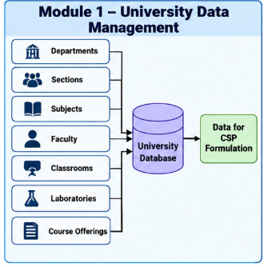
Module Description
1. University Data Management Module
This module manages the university information required for timetable generation. It maintains details about departments, subjects, faculty members, classrooms, and laboratories using an SQLite database. The stored information is retrieved and supplied to the scheduling process, ensuring that timetable generation uses the relevant academic and resource data.

Slide 21
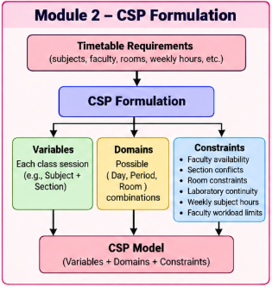
Module Description
2. CSP Formulation Module
This module represents the university timetable scheduling problem as a Constraint Satisfaction Problem (CSP). Each class session is treated as a variable, with possible day, period, and room combinations forming its domain. Scheduling requirements are represented as constraints, including faculty availability, room allocation, section conflicts, workload limits, and laboratory requirements. This formulation provides the foundation for applying CSP search techniques to generate feasible timetables.

Slide 22
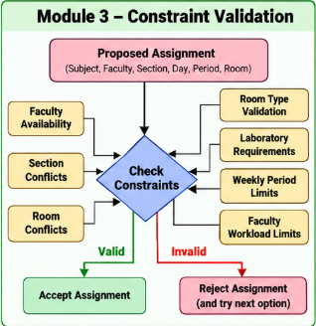
Module Description
3. Constraint Validation Module
This module checks whether timetable assignments satisfy the defined scheduling constraints. It verifies faculty availability, prevents classroom and section conflicts, checks faculty workload limits, and validates laboratory scheduling requirements. Assignments that violate mandatory constraints are rejected during the scheduling process. This helps maintain the consistency and validity of the generated timetable.

Slide 23
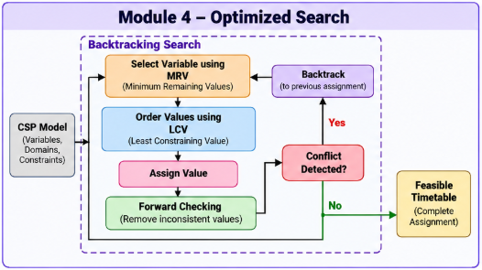
Module Description
4. Optimized Search Module
This module generates feasible timetables using Backtracking Search and optimization techniques. MRV selects variables with the fewest available options, while LCV prioritizes assignments that restrict other variables the least. Forward Checking detects conflicts early by updating the available options for unassigned variables, helping guide the search towards a valid timetable.

Slide 24
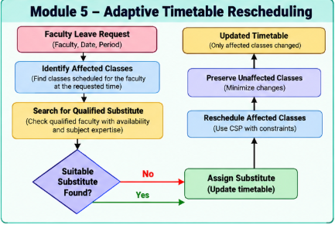
Module Description
5. Adaptive Timetable Rescheduling Module
This module handles faculty absences by identifying affected classes and checking for qualified, available substitute faculty. If a suitable substitute is unavailable, the system uses CSP-based rescheduling to find an alternative time slot. The revised timetable is validated and updated while preserving unaffected assignments, minimizing unnecessary changes to the existing schedule.

Slide 25
Results & Discussion
Parameter | Configuration
Departments | 6
Sections per department | 2
Total sections | 12
Working days | Monday–Friday
Periods per day | 7
Duration per period | 50 minutes
Lunch break | 11:20 AM–12:20 PM
Laboratory duration | 2 consecutive periods

Slide 26
Results & Discussion
Metric | Observed Result
Affected classes | 1
Rescheduled classes | 1
Classes covered by substitute | 0
Unchanged assignments | 365
Timetable stability index | 99.73%

Slide 27
Results & Discussion
Discussion
The application successfully demonstrated selective timetable adaptation.
Only the affected assignment was changed in the observed scenario.
The remaining assignments were preserved.
The stability index indicates that the change had limited impact on the timetable.

Slide 28
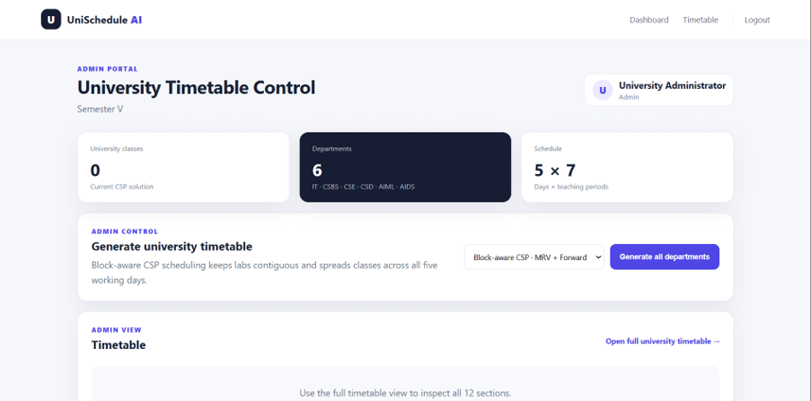
User Interface / Screenshots
Figure 1 - Administrator Dashboard

Slide 29
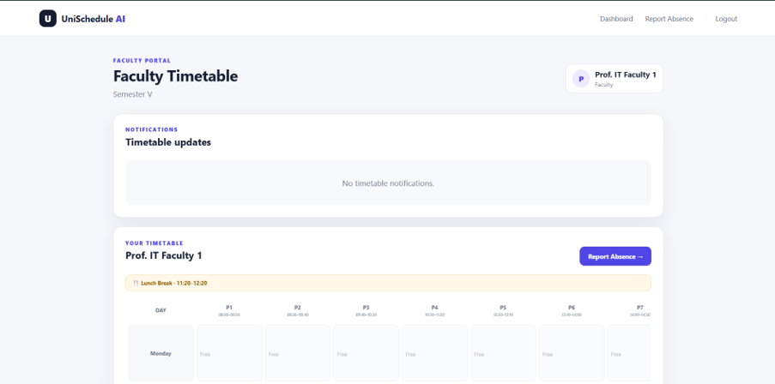
User Interface / Screenshots
Figure 2 – Faculty Dashboard

Slide 30
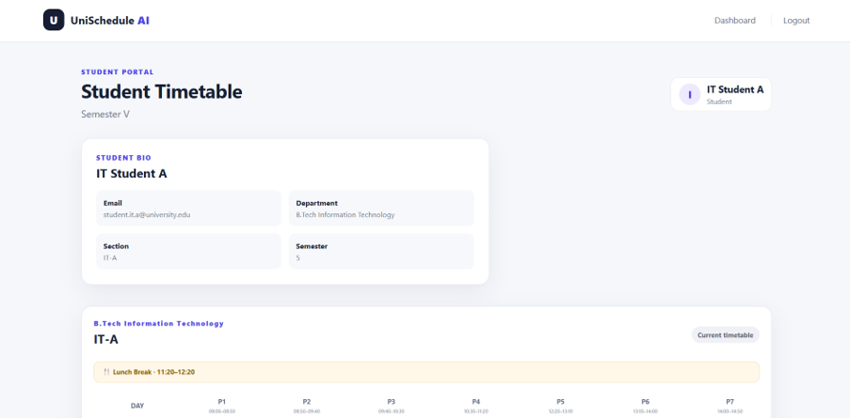
User Interface / Screenshots
Figure 3– Student Dashboard

Slide 31
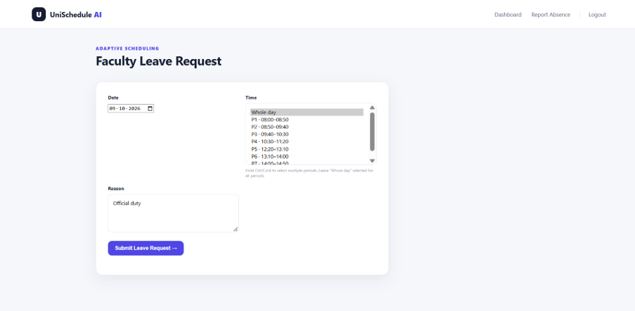
User Interface / Screenshots
Figure 4 - Faculty Absence Reporting Interface

Slide 32
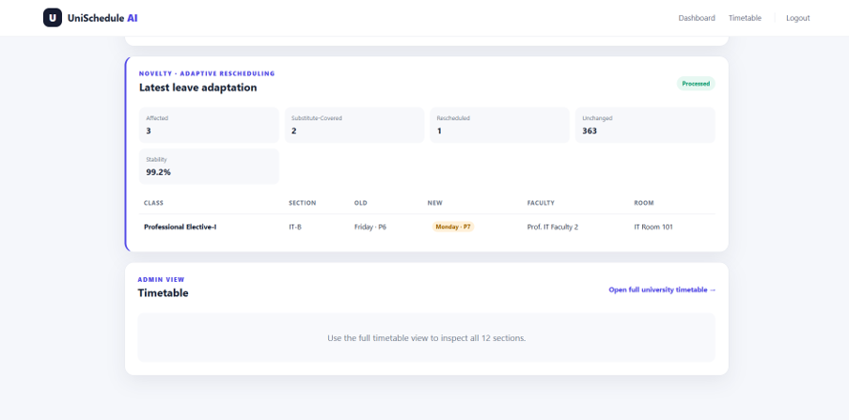
User Interface / Screenshots
Figure 5 - Admin Adaptive Rescheduling Result

Slide 33
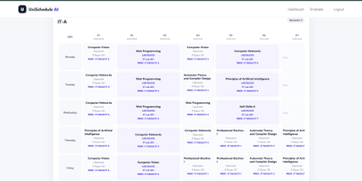
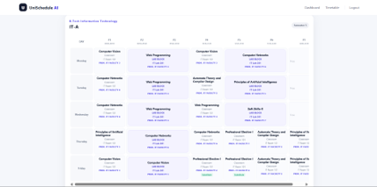
User Interface / Screenshots
Figure 6 & 7 - Before and After Timetable

Slide 34
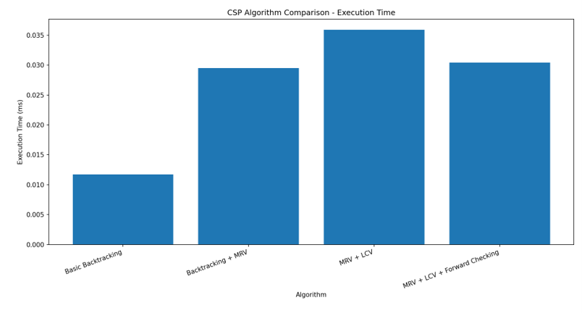
User Interface / Screenshots
Figure 8 - Before and After Timetable

Slide 35
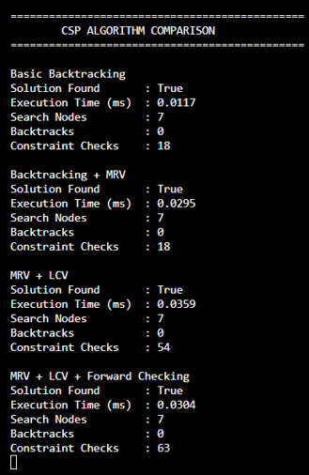
User Interface / Screenshots
Figure 9 - Comparison Statistics

Slide 36
Conclusion
The project successfully implements an intelligent university timetable generator using Constraint Satisfaction Problem (CSP) techniques. By integrating Backtracking Search, MRV, LCV, and Forward Checking, the system generates feasible timetables while satisfying academic and resource constraints. The web-based application supports university data management, constraint validation, and optimized scheduling. Additionally, the adaptive rescheduling module handles faculty absences through substitution or CSP-based rescheduling while preserving unaffected timetable assignments. Overall, the system aims to improve scheduling efficiency, reduce conflicts, and minimize unnecessary changes to existing timetables.

Slide 37
Future work
Advanced Optimization: Explore additional CSP heuristics to improve scheduling efficiency for larger datasets.
Enhanced Faculty Substitution: Incorporate more detailed faculty expertise, availability, and workload preferences.
Multi-Constraint Optimization: Consider faculty preferences, classroom suitability, and student scheduling preferences.
Performance Evaluation: Compare search strategies using execution time, search nodes, backtracking count, and constraint checks.
Enhanced User Interface: Improve timetable visualization and provide notifications for faculty absences and schedule changes.
Scalability: Extend the system to support more departments, sections, and academic institutions.

Slide 38
References
[1] Zhang, L., & Lau, S. K. (2005). Constructing university timetable using constraint satisfaction programming approach. Proceedings of the International Conference on Computational Intelligence for Modelling, Control and Automation, 2, 55–60. https://doi.org/10.1109/CIMCA.2005.1631445
[2] Abdelraouf, I., Abdennadher, S., & Gervet, C. (2011). A visual entity-relationship model for constraint-based university timetabling. arXiv. https://arxiv.org/abs/1109.6112
[3] Ceschia, M., Di Gaspero, T., Schaerf, A., & others. (2022). Educational timetabling: Problems, benchmarks and state-of-the-art results. Annals of Operations Research.

Slide 39
References
[4] Cheng, C., Kang, L., Leung, N., & White, G. M. (2005). Investigations of a constraint logic programming approach to university timetabling. Lecture Notes in Computer Science.
[5] Burke, E. K., Mareček, J., Parkes, A. J., & Rudová, H. (2009). Decomposition, reformulation, and diving in university course timetabling. Operations Research Proceedings. https://arxiv.org/abs/0903.1095

Slide 40
Thank You

